Slide 1
Insights into post disaster recovery planning
A systems approach

Slide 2


Disaster Recovery super heroes
In Norse mythology, Thor is a hammer-wielding god associated with thunder, lighting, storms, oak trees, strength, the protection of mankind, and also hallowing, healing, and rebirth.
Deadpool (real name Wade Winston Wilson) is an antihero with accelerated healing power that allows him to regenerate damaged or destroyed areas of his cellular structure making him immune to diseases.

Slide 3
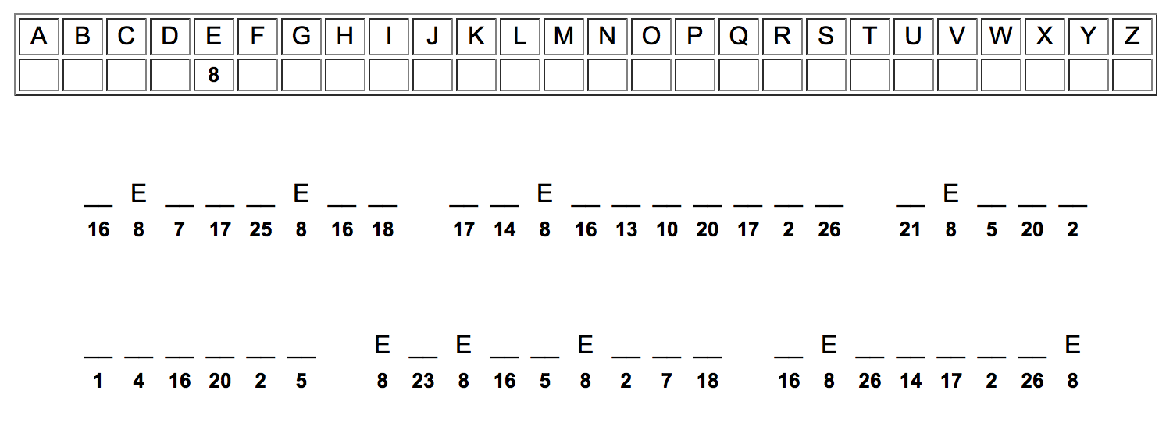
Creative thinking (code breaking)
Directions: This puzzle is called a Cryptogram. At the top there is a KEY that lists all the letters from A thru Z with an empty box below. Each of the letters has a corresponding number. The bottom part contains a secret phrase. Each of the blanks has a number underneath it. Break into teams to fill in the letters that correspond to the numbers below the blanks to solve the phrase. You have 5 minutes to complete this.

Slide 4
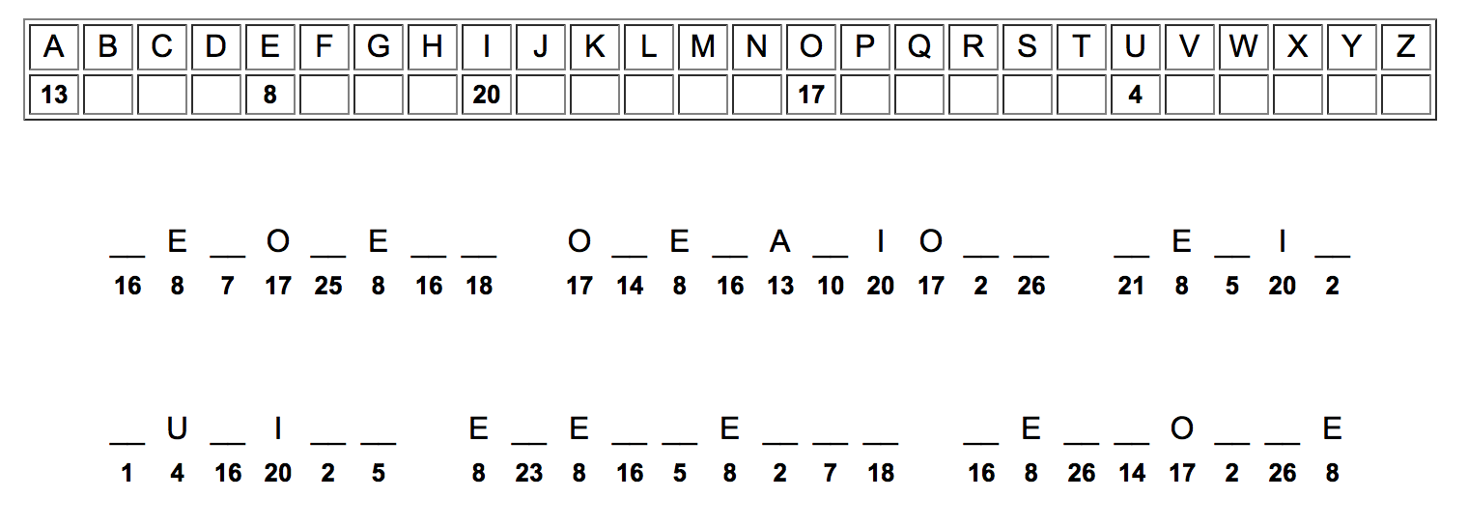
Additional clue

Slide 5
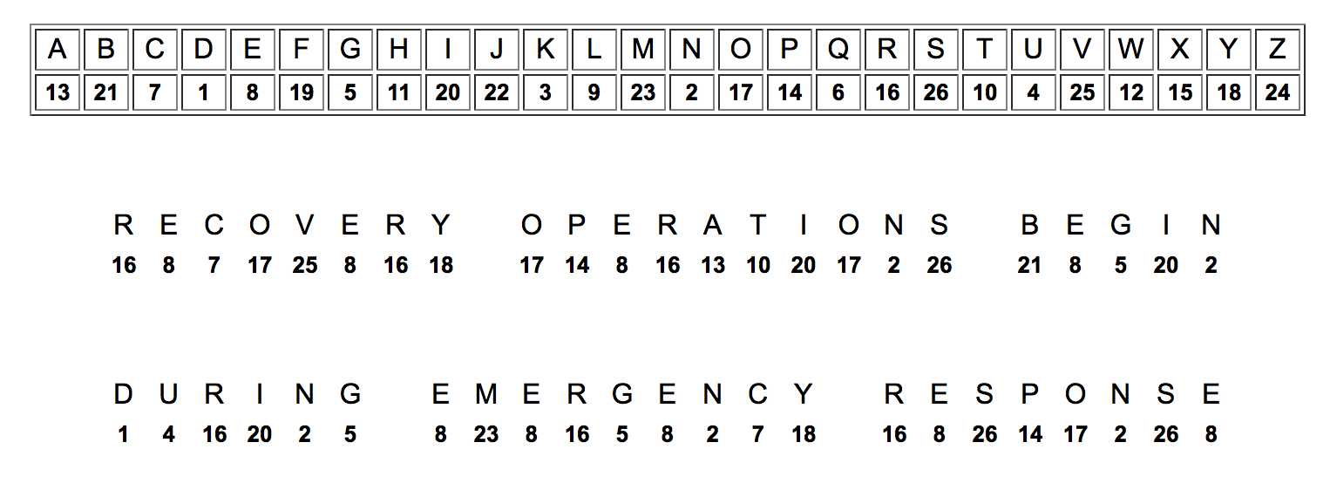
Answer key
What technique did your group use to solve the cryptogram?

Slide 6
Part 1
Disaster Recovery planning process

Slide 7
Post disaster Recovery planning
Disaster recovery planning creates new challenges for communities.
Coordinating projects, activities, and issues of communities and governments become new priorities.
Community involvement is necessary and critical element of post disaster recovery planning.
A community vision inspires recovery activities, facilitates a unity of purpose and provides long-term direction.

Slide 8
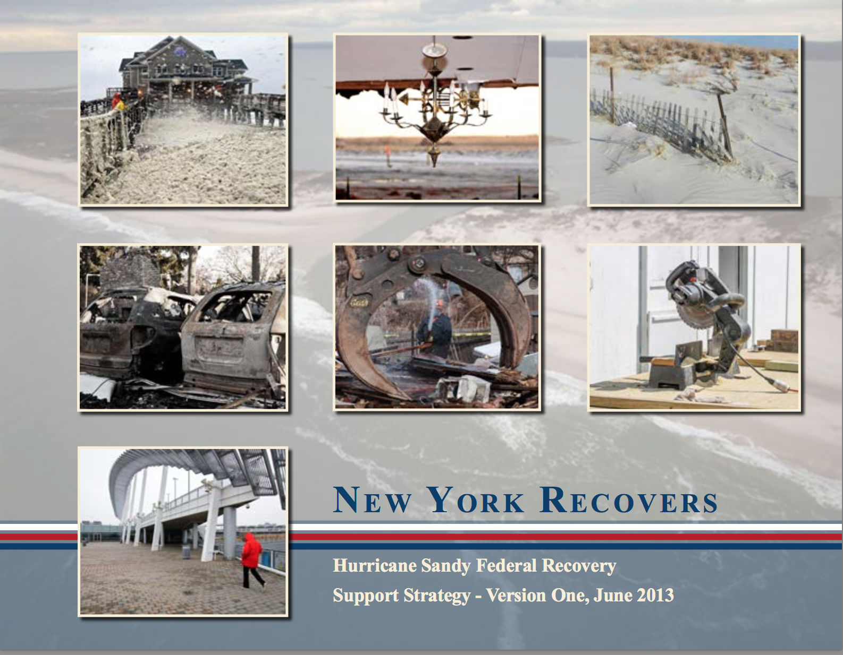
Recovery support strategy (RSS)
The RSS serves as the blueprint to guide an impacted community recovery activities to rebuild after the impacts of a catastrophic disaster, reduce vulnerabilities, and build resilience for future incidents.
Notes:
It is not a prescriptive Recovery Plan; rather, it is an overview of the strategy for providing integrated federal assistance in support to the District.

Slide 9
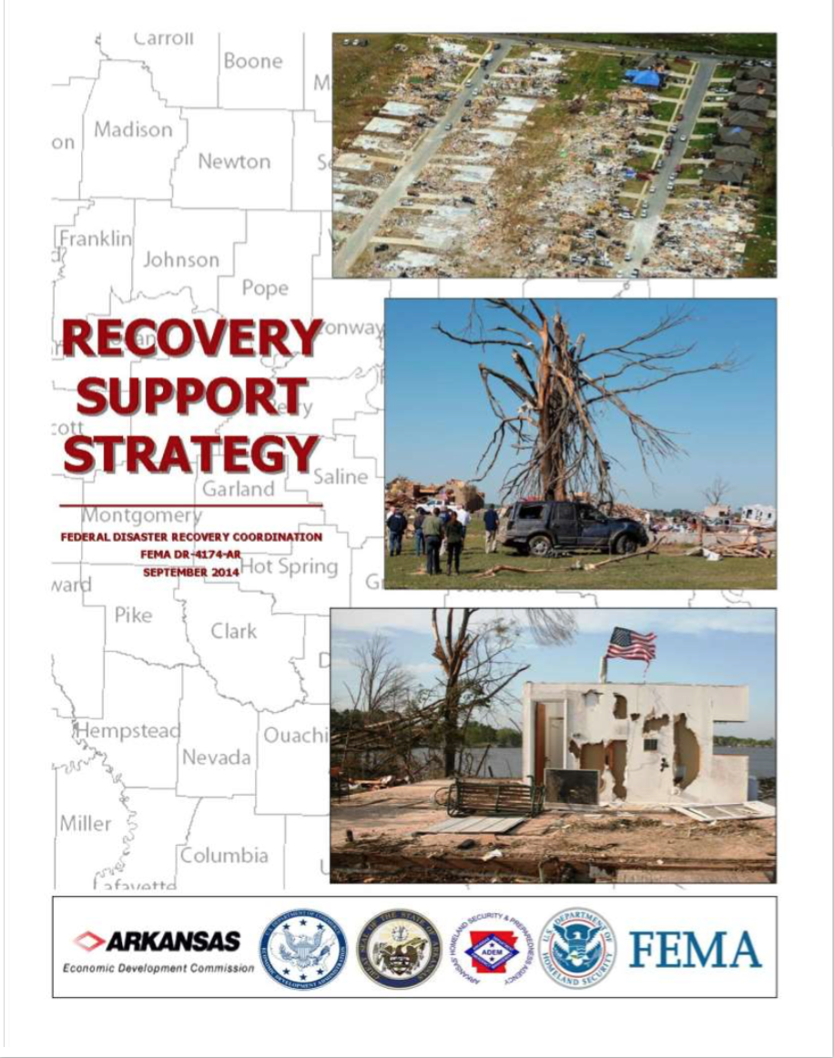
Recovery support strategy cont.
The RSS identifies how the State Disaster Recovery Coordinator and/or the Local Disaster Recovery Manager will contribute to the following:
  Develop, coordinate, manage, lead, and implement its individual community recovery plans.
  Help bridge resource shortfalls. The RSS provides an anticipated timeline for engaging with impacted communities, and the level, type, and duration of support to be provided.

Slide 10
Recovery support strategy cont.
Typically one RSS is developed for each jurisdiction requiring recovery activities in a joint effort between the impacted jurisdiction and the applicable FEMA Region.
Developing a single RSS will ensure that the multitude of simultaneously occurring recovery projects led by the impacted jurisdiction, including those supported with federal resources, are integrated and streamlined.
The community should set the overall recovery vision; the SDRC/LDRM and the RSFs lead the develop of the RSS in coordination with the Federal Disaster Recovery Coordinator (FDRC), national RSF Field Coordinators, and the National Disaster Recovery Support (NDRS) Workforce Reservists.

Slide 11
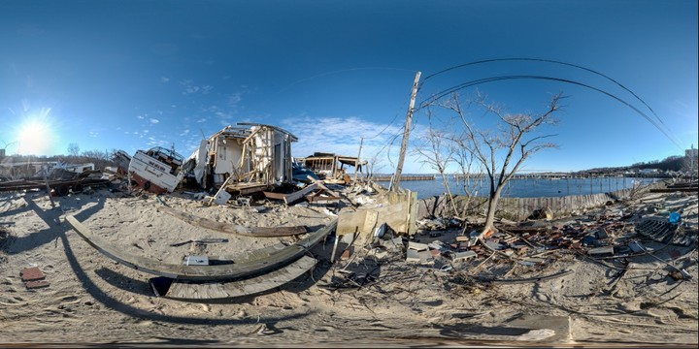
What is the process to develop a Recovery support strategy?
The Recovery “R” Concept

Slide 12
the Recovery “R”?
To facilitate development of the RSS, a Recovery “R” concept has been created that identifies key meetings, special considerations, and a systematic approach to organize recovery planning activities.
It is designed to promote effective decision-making and the integration of community recovery planning with government policy decisions into implementation efforts.
The Recovery “R” can be used during all recovery efforts in which the impacted community is engaged for both Stafford Act and non-Stafford Act disasters.

Slide 13
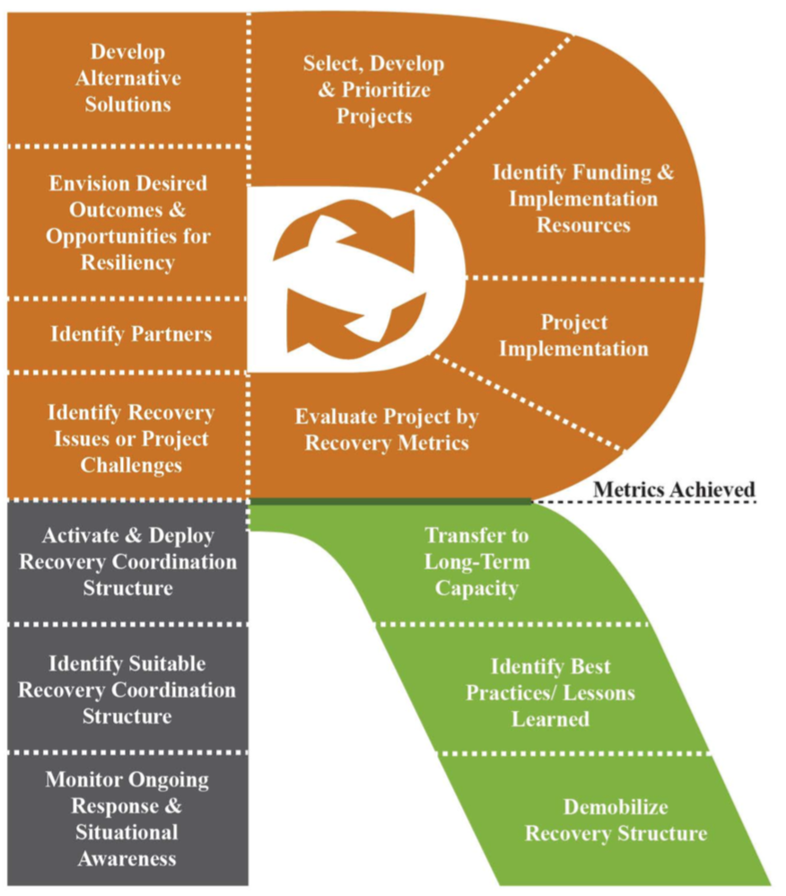
meet the recovery ”R”
The Recovery “R” is designed similar to the IAP Planning “P”; however, the implementation of the processes in the “R” will continue over a longer period of time than a single operational period and is concluded after the RSS has been executed to the community’s desired end state.

Slide 14
How does it work?
The leg of the “R” begins the Recovery “R” during response operations and includes the initial transition from response to recovery operations and establishes the organizational structure for recovery.
The loop of the Recovery “R” is a circular process working through the RSS planning process until the projects and state of the impacted community has improved to a condition where implementation benchmarks are reached.
The stem of the “R” begins once implementation benchmarks are reached and the recovery organization can demobilize to transfer ongoing recovery efforts to day-to-day governmental and nongovernmental authorities to oversee the remaining implementation of the projects until the community’s desired end state has been achieved.

Slide 15

Taking a closer look
The Recovery “R” Steps

Slide 16
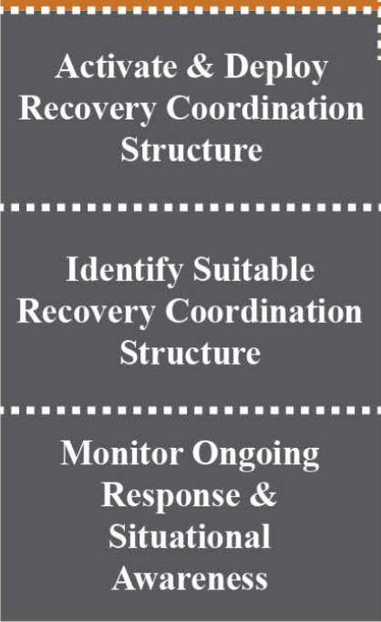
The Leg of the recovery “R”
Monitor response operations.
Conduct preliminary damage assessment.
Understand the scale and spectrum of the damages.
Establish recovery organization.
Appoint SDRC/LDRC.

Slide 17
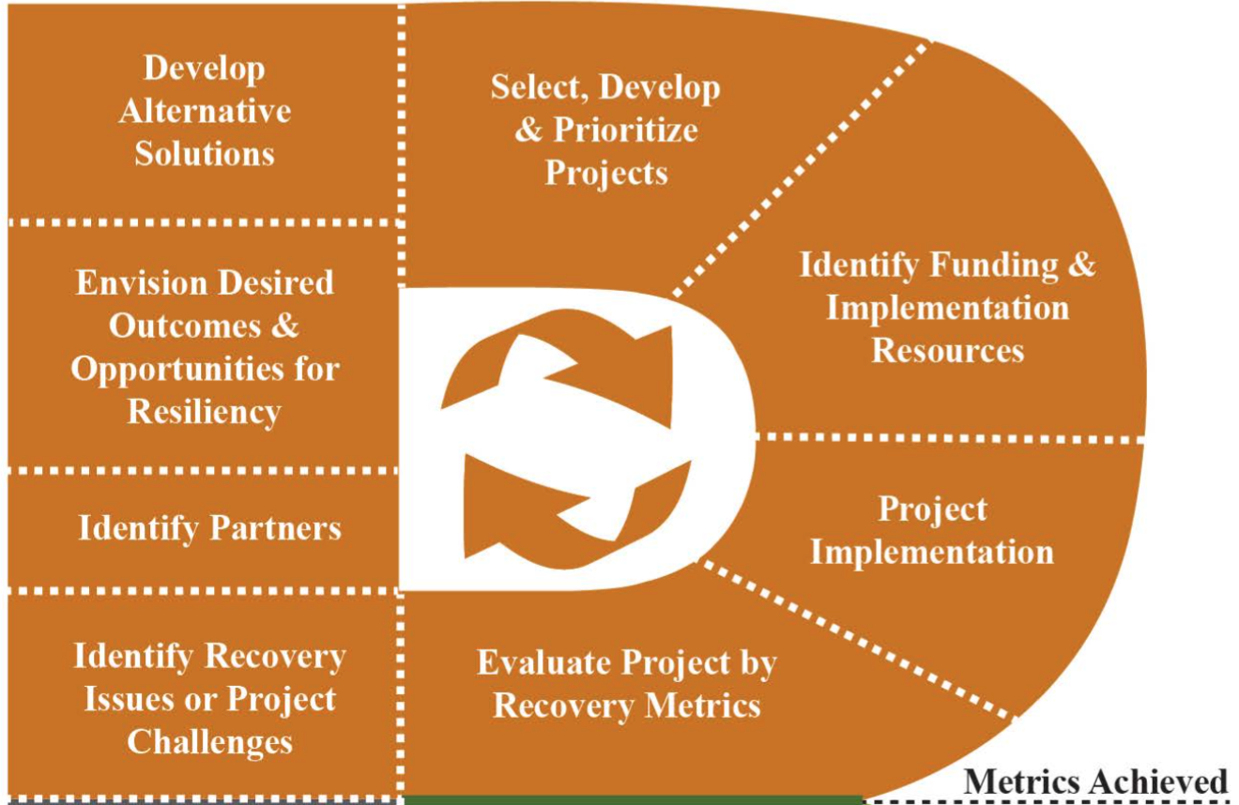
The beginning of the loop of the “R”
Conduct community engagement meetings.
Create community vision and formulate goal statements.
Establish recovery targets.
Develop a public participation plan.
Identify mitigation planning and project opportunities.

Slide 18
The loop of the recovery ”R”
Identify challenges or issues that could prevent progress toward success of recovery goals.
Identify policies, ordinances, or legislation that needs to be enacted to expedite recovery activities.
Align projects with each recovery goal.

Slide 19
The loop of the recovery ”R”
Conduct risk management and cost benefit analysis on proposed projects.
Establish criteria to prioritize projects.
Select and prioritize projects.
Determine what funding and resources are available to support projects.

Slide 20
The loop of the recovery ”R”
Compile data, vision, goals, targets, projects, and resources into the RSS.
Assemble RSS.
Public reviews RSS.
Jurisdiction adopts RSS.

Slide 21
The loop of the recovery ”R”
Track recovery key performance indicators.
Assess recovery projects.
Revise criteria to prioritize projects as necessary to fit current needs of community.
Evaluate the effectiveness of adopted recovery policies, ordinances, and legislation.

Slide 22
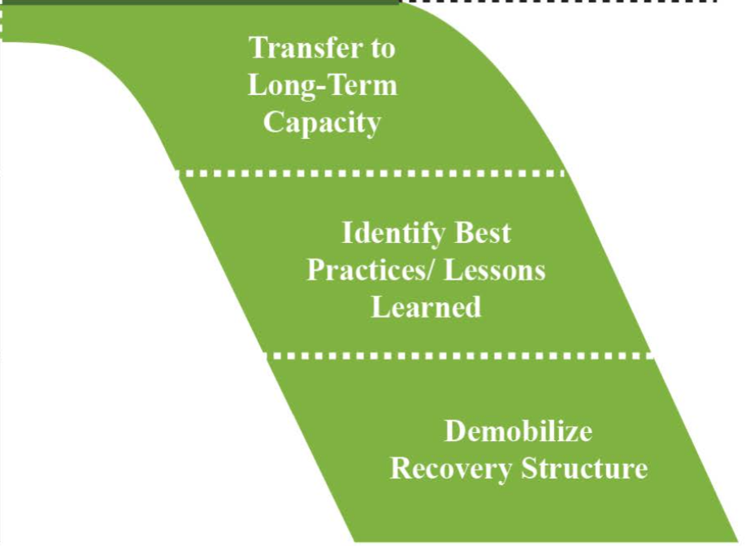
THE STEM OF THE RECOVERY “R”
Based on RSS implementation progress, transfer to long-term recovery capacity.
Continue to track recovery progress.
Deactivate recovery organization when projects begin to look like “normal planning” considerations.

Slide 23
RSS implementation
RSS presents a snapshot in time; the document will evolve through multiple iterations to reflect new data, more detailed recovery strategies, and more links and resources to be leveraged in support of recovery. For example, the RSS should be updated every six months or no less than once a year.
The development of the RSS is typically started within the first two months of a major disaster and takes several months to complete allowing a public review period by the impacted communities.
The implementation of the RSS usually beings during intermediate recovery through long-term recovery, which can continue for years until the impacted communities have returned to their desired end state.

Slide 24
allows all parties to track the progress of reconstruction – who is doing what and where - is essential to coordinating an effective recovery, and good for public morale
When describing the pressing need for a systematic approach to monitoring and evaluating recovery and reconstruction following a disaster
Cambridge Architectural Research Limited

Slide 25
Part 2
Measuring success in a post disaster recovery environment

Slide 26
What is success?
As defined by the Merriam-Webster dictionary:
  Obsolete – Outcome, result
  Degree of measure of succeeding
  Favorable or desired outcome
Notes:
Ask the audience: What does success mean to you?
[Collect 3 – 4 responses from the audience]
People measure success in many different ways and on many different levels. When setting goals in life, work, or in a post disaster recovery environment, it’s important that we identify what success means to us personally, so that when we succeed we will know it.
For example, most people measure success in business according to their income; however this may not be an accurate assessment. If your business efforts provide a substantial monetary reward but you don’t enjoy what you do, can this really be called success?
If on the other hand, we were measuring financial success then income would be an accurate indicator. Knowing what you expect from your business in advance gives you a way to measure success and to gauge your progress.

Slide 27
Measuring success in recovery
Communities are complex interdependent systems and following a disaster, it is critical to measure and monitor how well a community is recovering from a disaster over time.
The recovery process is informed by measuring baseline data against agreed upon recovery goals and targets.
Recovery measures can be developed that are flexible, easy to assess, cost- effective, and useful for decision making in operations, policy, or during pre-disaster planning.
Notes:
The process of identifying recovery metrics that are customized for a community’s setting, context, and values is a challenge but can be overcome.

Slide 28
Establishing recovery metrics
Valid and reliable metrics that can be utilized across disasters, over time, and in different jurisdictions are a necessary part of increasing resilience by providing data to inform planning, preparedness, and mitigation strategies.
Recovery should provide an opportunity to improve upon, rather than recreate, pre-disaster vulnerabilities.
Recovery metrics need to be created with systematically collected and shared data that characterize the baseline conditions of a community.
Notes:
Recovery metrics to measure recovery success should use baseline data that is captured and track BEFORE a disaster strikes. [Ask the audience] Why before a disaster? Answer: To be able to measure the delta or change in the data set.
Your communities planning team can identify of a robust set of recovery indicators, with quantifiable metrics for assessing the effectiveness of recovery efforts. We will talk more about this in just a little while.

Slide 29
How to measure recovery
Establishing Recovery Indicators

Slide 30
Recover indicators
Recovery indicators offer relevant feedback throughout the post-disaster Recovery Support Strategy implementation process.
Each recovery indicator are linked to recovery goals, targets, all the way to the individual project level.
Analysis of recovery indicators can also be used to convert information into intelligence for policy decisions.
Notes:
The key to designing indicators linked to recovery goals, targets, down to the individual project level is to determine how change can be measured in an understandable manner with data that can be collected using already established mechanisms.
Recovery indicators should be selected from data sets that are already collected in a pre-disaster environment.

Slide 31
Example recovery indicators
Recovery Support Function | Linked Recovery Goal/Target/Project | Indicator
Economic | Economic resumption to keep business operating | % preexisting business operating % jobs restored
 | Economic well-being | Consumer price index Unemployment index Jobless claims per month
Notes:
Recovery indicators can be organized by recovery support function and linked goals/targets/projects.

Slide 32
Example recovery indicators Continued
Recovery Support Function | Linked Recovery Goal/Target/Project | Indicator
Infrastructure | Replace/repair infrastructure to desired conditions Economic well-being | % of re-established transportation systems Miles of disaster damaged road and bridges repaired

Slide 33
Example recovery indicators Continued
Recovery Support Function | Linked Recovery Goal/Target/Project | Indicator
Natural, Cultural, and Historical Resources | Restoration of Cultural Sites | Number of museums open Number of public parks open % of repaired religious facilities Number of professional sport organizations operating

Slide 34
Considerations when establishing recovery indicators
Does the indicator account for goals that reflect community needs and aspirations?
Can the indicator be customized to fit an individual government agency, non-governmental organization, or private organization for execution?
Is the cost/benefit relationship acceptable?
Will the measure be sustainable to track performance over a period of time (e.g., days, months, years)?

Slide 35

Case study
District of Columbia: Disaster Recovery Scorecard

Slide 36
Recovery scorecard
The District of Columbia (District) has developed a recovery scorecard to provide a systematic, independent, and replicable approach to monitor and evaluate the recovery efforts.
The scorecard is composed of a set of recovery indicators arranged by the District’s recovery support functions.
The scorecard may be displayed in tables, charts, and graphs to demonstrate progress to measure success.
The District established 20 – 30 recovery indicators for each recovery support function.

Slide 37
District recovery scorecard
Education Services
Number of schools (K-12) closed vs. open
State college enrollment numbers
Government Services
Number of agency continuity of operations plan activated
Number of District employees
Housing
Number of displaced people by neighborhood
Number of housing units relocated from hazard zone

Slide 38

Brainstorming activity
Discovering Recovery Indicators

Slide 39
Recovery indicators
Side #1
Now that you know the importance of measuring recovery progress, and the secrets of validating metrics– let’s create some recovery indicators.
On one side of your index card, write a recovery goal, target, or project.
On the other side of the index card write three recovery indicators to measure its progress.
Pass your index card forward, let’s discuss.
Recovery Goals, Target, Projects
Side #2
Three recovery indicators

Slide 40


Meet the Masters of disasters
Ms. Carrie Speranza, CEM is the Manager of Federal Preparedness Programs at Hagerty Consulting. She has 12-years of experience in emergency management with experiencing ranging from long-term disaster deployments, to policy and planning consultation at the local, state, and federal levels. Ms. Speranza specializes in program management, change management and strategic planning – working with clients to organize, evolve, and assess their emergency management programs and core competencies. Ms. Speranza is the current IAEM Region 3 Secretary/Treasurer.
Mr. Justin Pierce is a Regional Coordinator at Tetra Tech Inc., he brings 12-years of progressive experience in the areas of homeland security policy, emergency management, long-term disaster recovery, and all-hazards planning. Prior to joining Tetra Tech Inc., he was the Deputy Emergency Management Coordinator for the City of Alexandria, VA. Justin earned a Bachelor of Arts in Political Science from Virginia Tech University and a project management certificate from Georgetown University.

Slide 41
Thank you
Ms. Carrie Speranza
Lead, Preparedness Technical Assistance Program
FEMA National Integration Center
Hagerty Consulting
Email: carrie.speranza@hagertyconsulting.com
Phone: 541-760-1136
Mr. Justin Pierce
Title: Regional Coordinator
Tetra Tech
Email: justin.pierce@tetratech.com
Phone: 703-577-8084

